Slide 1
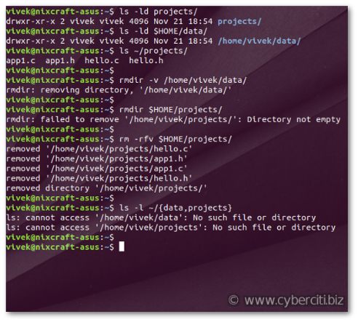
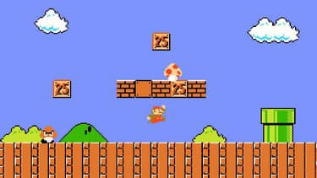
Python libraries
From terminal to gaming

Slide 2
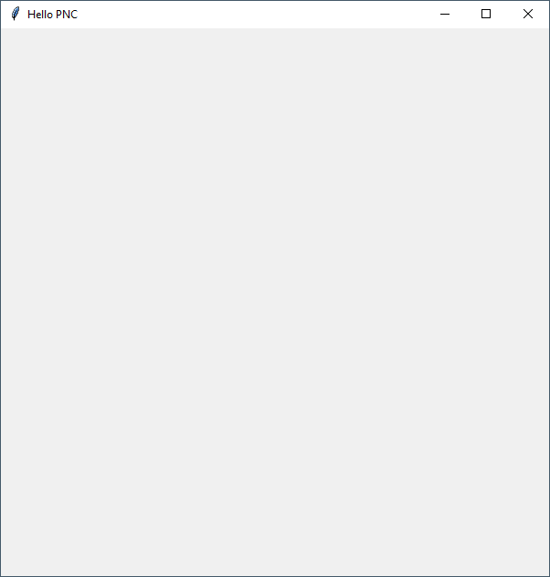
In the previous lesson
create_rectangle(x1, y1, x2, y2, optional parameters…)
x1 x2
10 50
x
0
y1 20
y2 100
y
create_rectangle(10, 20, 50, 100, fill="#0000FF")

Slide 3
Events
Events are used to track user interaction with the windows
Examples of events :
User click on a shape
User type on the keyboard
With TK you can trigger a function every time an event happens.

Slide 4
Events
Trigger function should always have a parameter « event »
def myEventTrigger(event):
print("User has clicked at position : ", event.x, event.y)
canvas = tk.Canvas(frame)
canvas.create_oval(50, 50, 300, 300, fill="red", tags="PNCTarget")
canvas.tag_bind("PNCTarget","<Button-1>",myEventTrigger)
Use « tag_bind » to link a function with an event
<Button-1> = left button of mouse
<Button-3> = right button of mouse
The function to call everytime the event will happen
Set a tag to the shape.
Similar to ID in HTML
Notes:
Demo on demo - display position of mouse on event.py and demo - move cicrcle on event

Slide 5
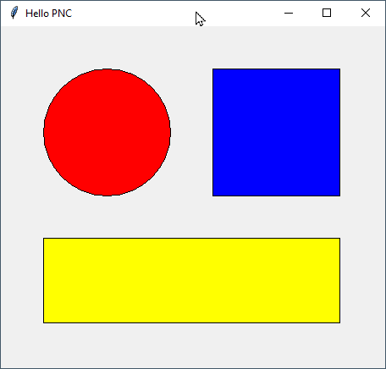
Activity 1
Practice
20 min
Create a window with 3 shapes
When use clicks on a shape print according to the shape clicked :
User clicks on circle
User clicks on square
User clicks on rectangle
Notes:
07-circle-rectangle.py

Slide 6
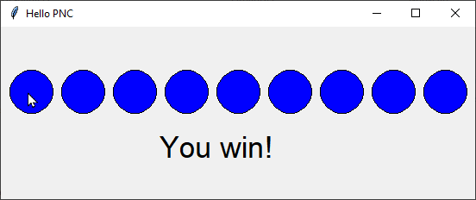
Secret circle game
Practice
20 min
Activity 2
Use « the line » code from previous exercise.
Change it : all circles should have the same color but one should be the « secret » circle
When user click on the secret circle it displays « you win »
Reminder :
canvas.create_text(x,y,text="You win!",font=("Purisa", 26))
Notes:
05-secret-circle-CORRECTION.py

Slide 7
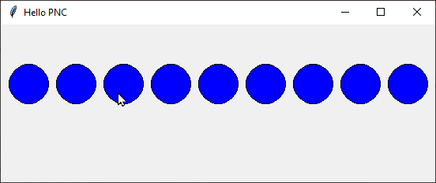
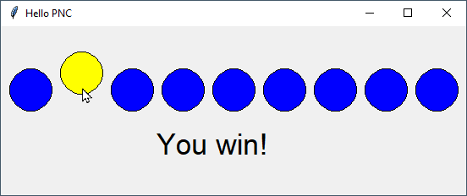
Game : Where is the secret ?
Practice
20 min
Activity 3
Upgrade your « Secret circle game » 🡺 Change the color of the secret circle when user click on it.
BEFORE CLICK ON THE SECRET CIRCLE
AFTER CLICK
Notes:
07-secret-circle-circle-color-CORRECTION.py

Slide 8
Let s SUMP UP
Events = call a function when user click or type text
An event can be bind to a shape with a tag
An event can also be bind to « root » (root is everywhere)
def myEventTrigger(event):
print("User have clicked at position : ", event.x, event.y)
randomColor = random.choice(colors)
canvas.itemconfig(oval, fill=randomColor)
canvas.move(oval, 10, 10)
canvas = tk.Canvas(frame)
colors = ["red", "orange", "yellow", "green", "blue", "indigo", "violet"]
oval = canvas.create_oval(50, 50, 300, 300, fill="red", tags="PNCTarget")
canvas.tag_bind("PNCTarget","<Button-1>",myEventTrigger)
root.bind("<Button-1>",myEventTrigger)
Change a shape position and color
Call function when click on shape
Call function when click anywhere

Slide 9
Homework research
Practice
20 min
Test this code. Try to understand the new concepts :
Can you guess what is the purpose of « random.choice » ?
Can you guess what is the purpose of « canvas.itemconfig » ?
Can you guess what is the purpose of « canvas.move » ?
Why did I use variable on line « oval = canvas.create_oval… » ?
def myEventTrigger(event):
print("User have clicked at position : ", event.x, event.y)
randomColor = random.choice(colors)
canvas.itemconfig(oval, fill=randomColor)
canvas.move(oval, 10, 10)
canvas = tk.Canvas(frame)
colors = ["red", "orange", "yellow", "green", "blue", "indigo", "violet"]
oval = canvas.create_oval(50, 50, 300, 300, fill="red", tags="PNCTarget")
canvas.tag_bind("PNCTarget","<Button-1>",myEventTrigger)
Notes:
06-events-demo.py

